Slide 1
Autoencoders for mSEM artifact detection

Slide 2
mSEM artifacts: general
mSEM artifacts are a problem for automated downstream analysis -> hinder classification / segmentation / agglomeration
mSEM artifacts come in various forms and are difficult to detect reliably using humans or hand-designed algorithms
Variety of artifacts and large data size
Problematic situation for classical supervised approaches (e.g. U-net)
Training a naive U-net or similar (>E6 params) in a supervised fashion would require HUGE amount of labeled training data

Slide 3
mSEM artifacts: data situation
Huge amount of unlabeled data (even in mag-8-8-1 ~1TB)
Much less labeled data (> 500 training patches ~ 10MB):
Lablog Summary: https://mhlablog.net/2020/02/05/training-data-for-artefact-detection-in-msem-data/
Circular Artifact: https://webknossos.brain.mpg.de/annotations/Explorational/5e387a00010000501b1a41bd#25238,20546,3546,0,0.513,1
Horse shoe Artifact: https://webknossos.brain.mpg.de/annotations/Explorational/5e387a00010000501b1a41bd#19895,15530,3732,0,0.513,12
Scratch Artifact: https://webknossos.brain.mpg.de/annotations/Explorational/5e387a00010000501b1a41bd#20088,16049,3925,0,0.513,17

Slide 4
Supervised CNN vs. unsupervised autoencoder (AE)
CNN
f: X ⟶ Y
y = f’(x) + ε
Min_{p}Loss(f’_{p}(x) - y)
----------------------
class CNN:
def predict(x):
y_hat = f(x)
return y_hat
AE
e: X ⟶ L
d: L ⟶ X
x = d’(e’(x)) + ε
Min_{p}Loss(d’_{p}(e’_{p}(x)) - x)
---------------------
class AE:
def predict(x)
x_hat = d(e(x))
return x_hat

Slide 5
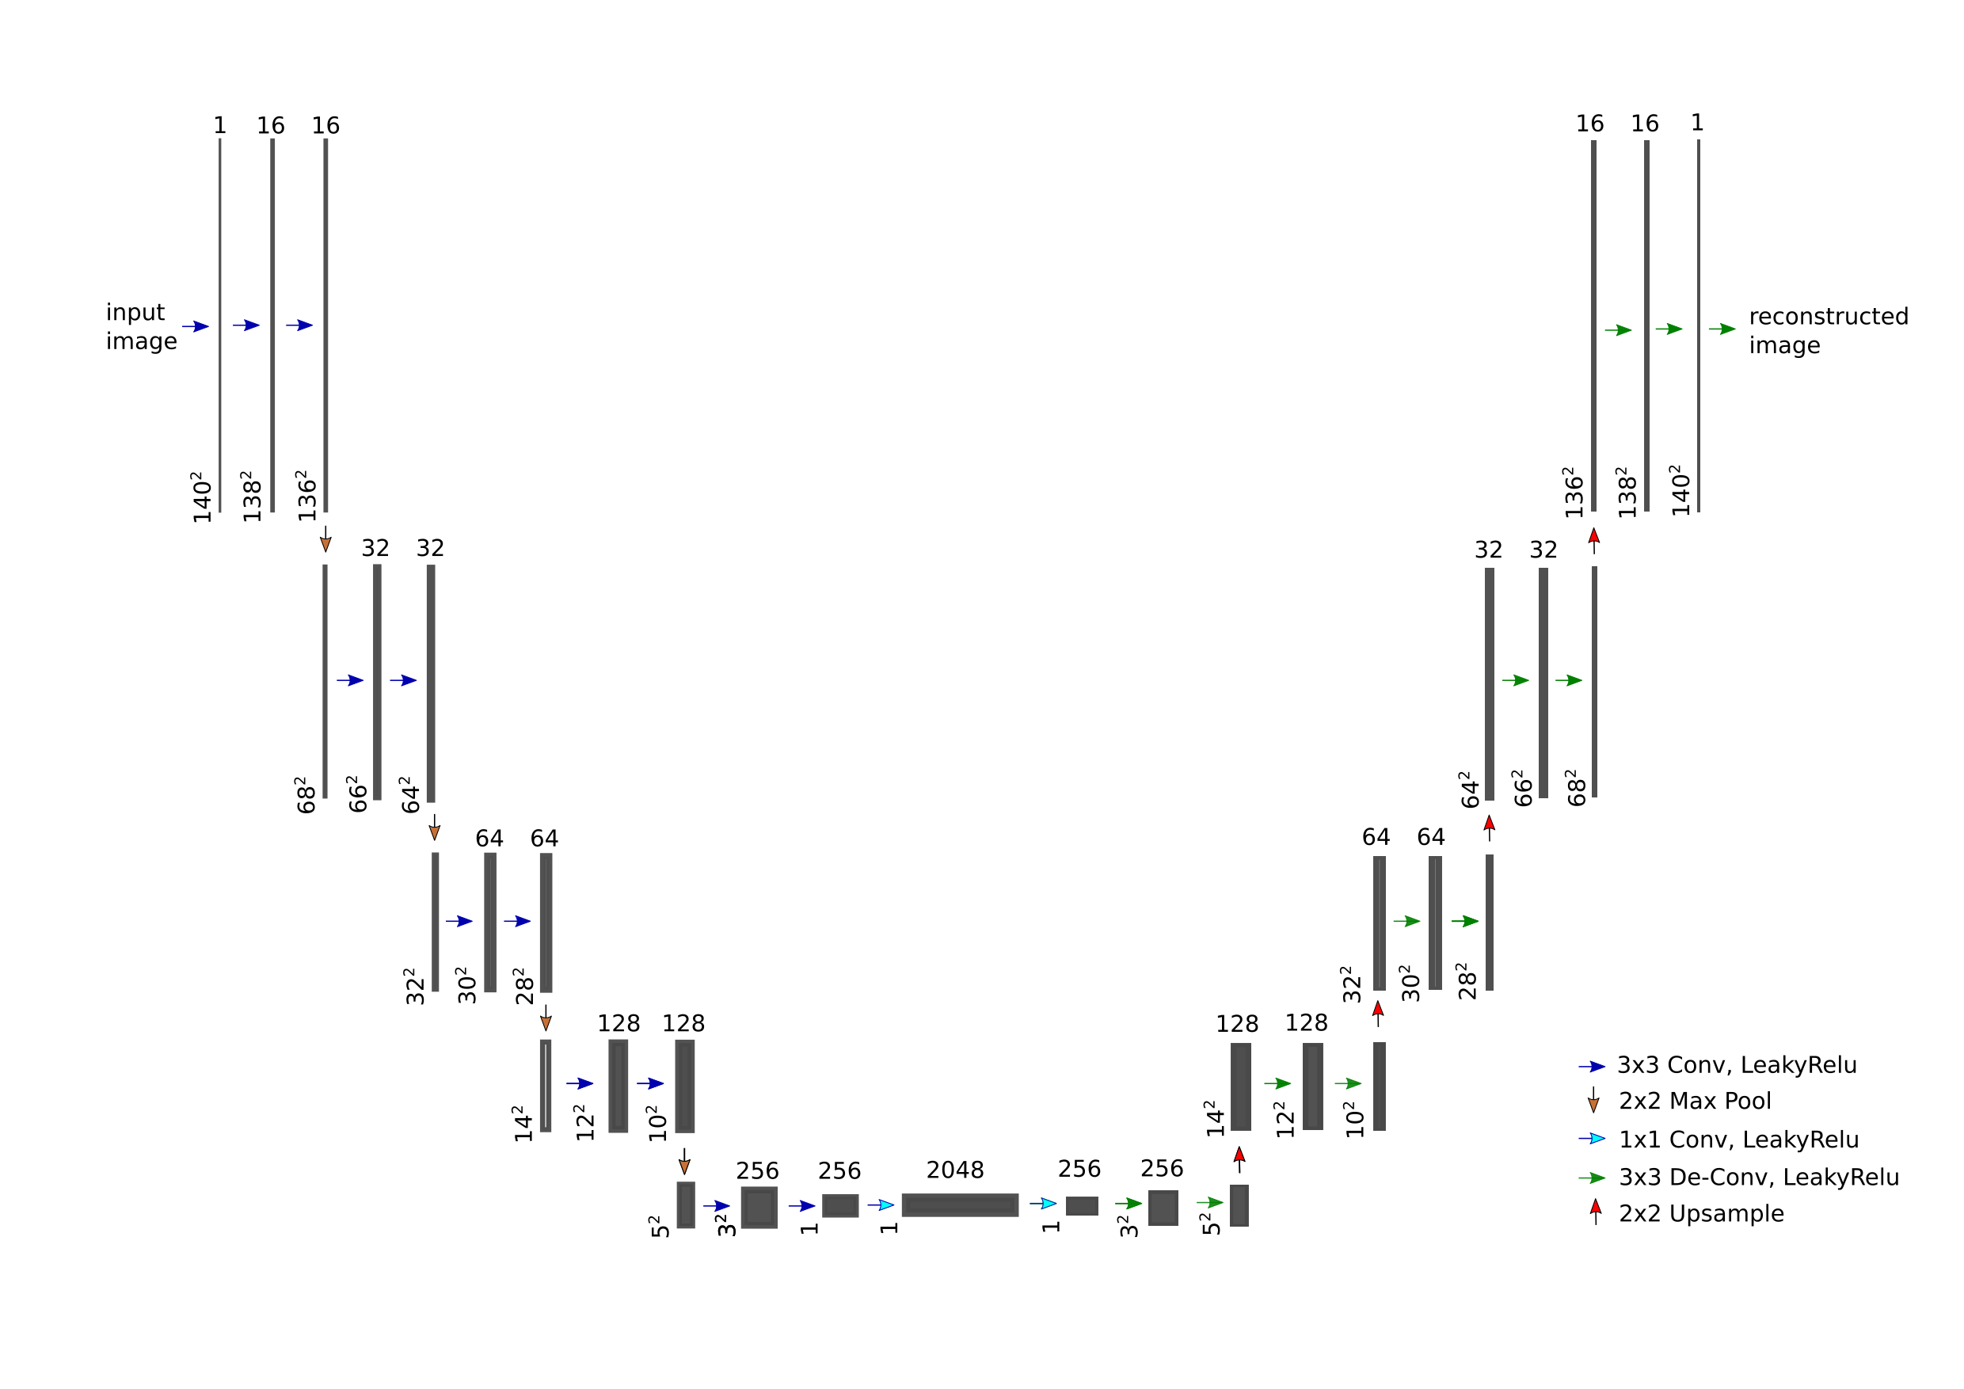
Basic multi-res AE for mSEM data

Slide 6
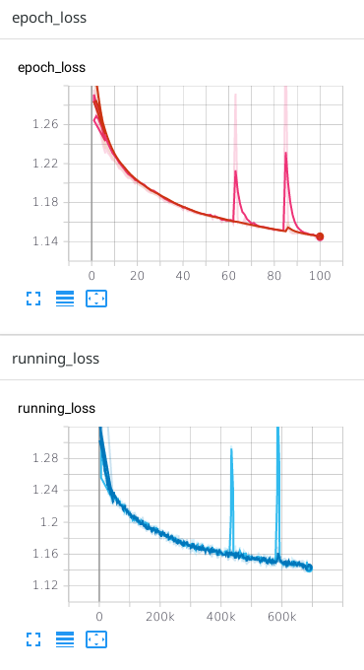
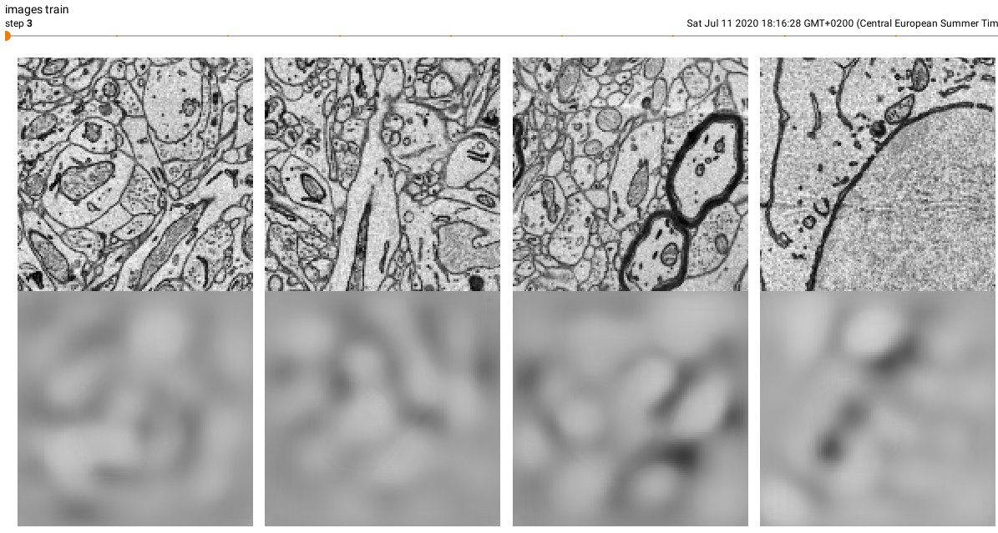
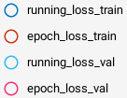
Basic multi-res AE for mSEM data

Slide 7
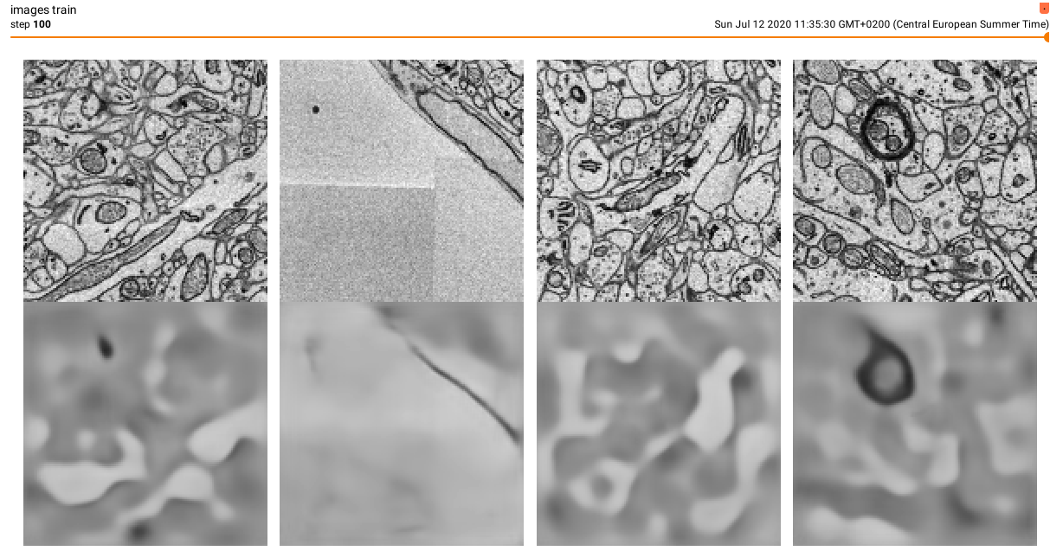
Basic multi-res AE for mSEM data

Slide 8
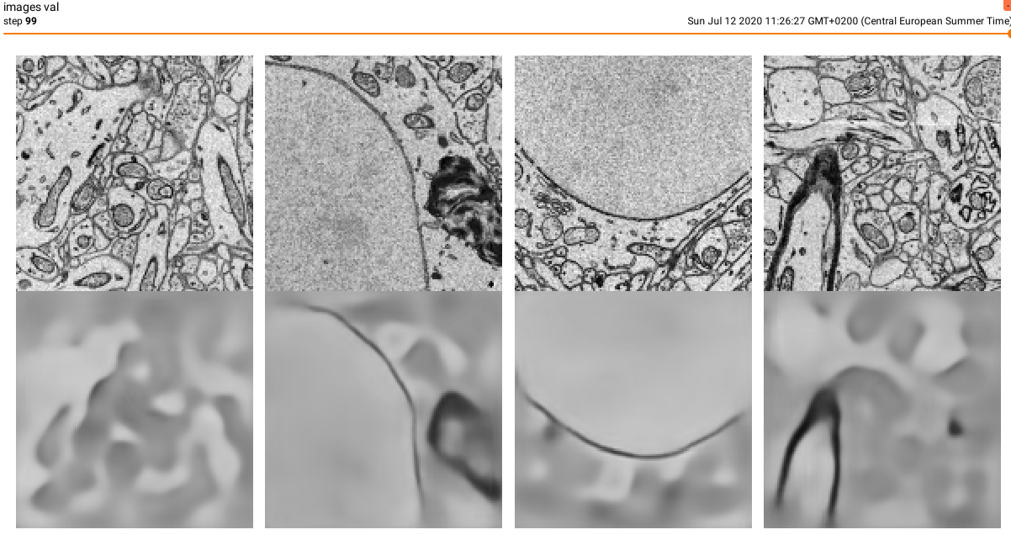
Basic multi-res AE for mSEM data

Slide 9
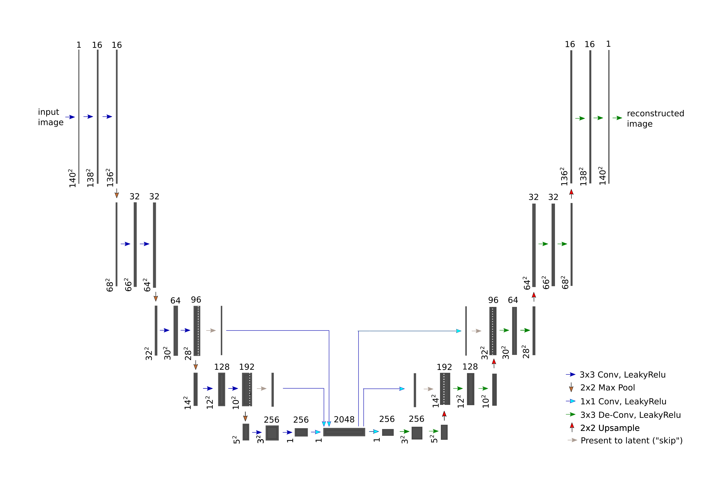
Multi-res “skip” AE for mSEM data

Slide 10
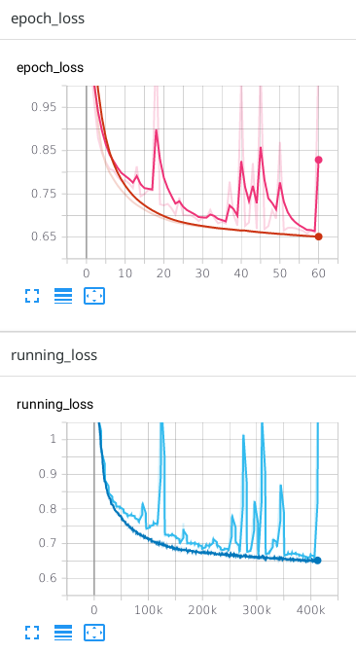
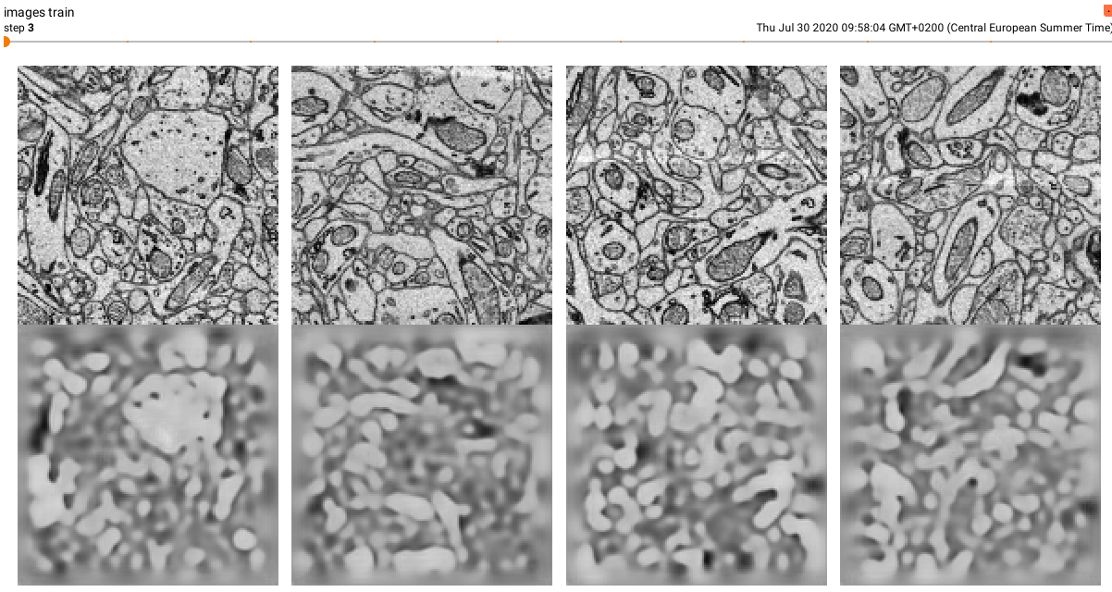
Multi-res “skip” AE for mSEM data

Slide 11
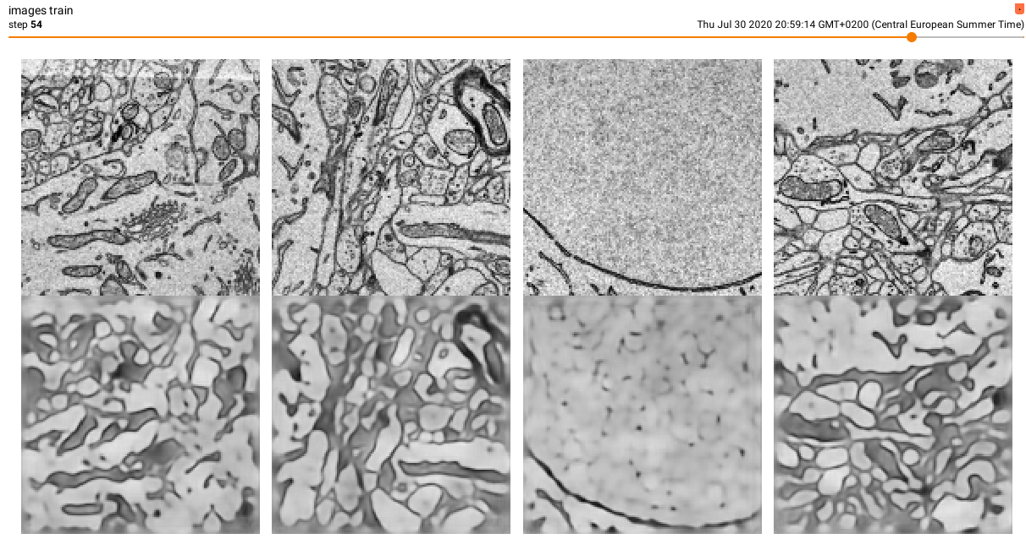
Multi-res “skip” AE for mSEM data

Slide 12
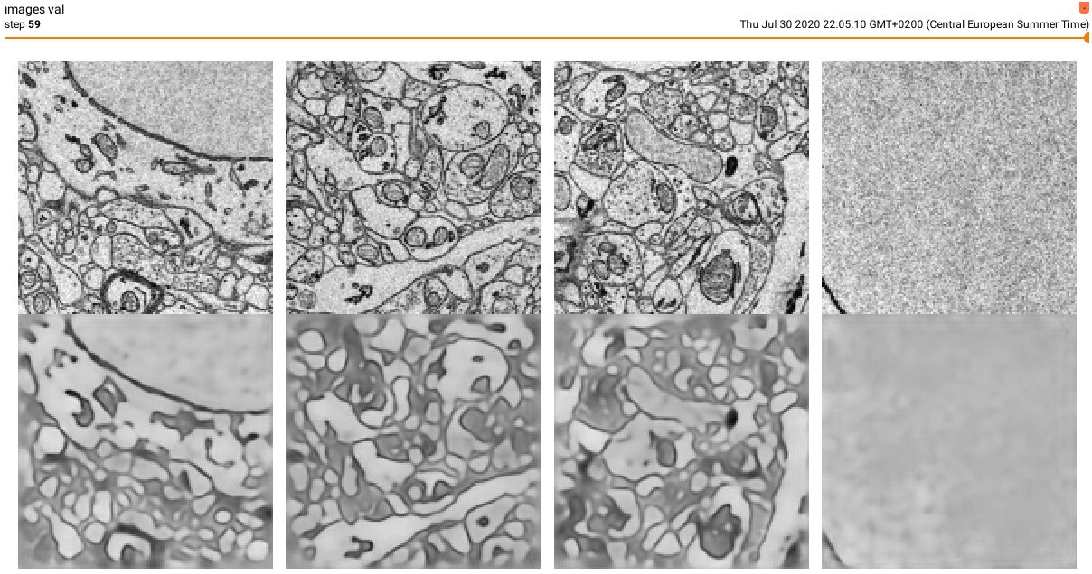
Multi-res “skip” AE for mSEM data

Slide 13
Multi-res “skip” AE for mSEM data

Slide 14
Unsupervised AE vs. semi-supervised encoder + classifier
AE
e: X ⟶ L
d: L ⟶ X
x = d’(e’(x)) + ε
Min_{p}Loss(d’_{p}(e’_{p}(x)) - x)
---------------------
class AE:
def predict(x)
x_hat = d(e(x))
return x_hat
Encoder + classifier
e: X ⟶ L
c: L ⟶ Y
y = c’(e’(x)) + ε
Min_{p}Loss(c’_{p}(e’(x)) - x)
---------------------
class EncoderClassifier:
def predict(x)
y_hat = c(e(x))
return y_hat

Slide 15
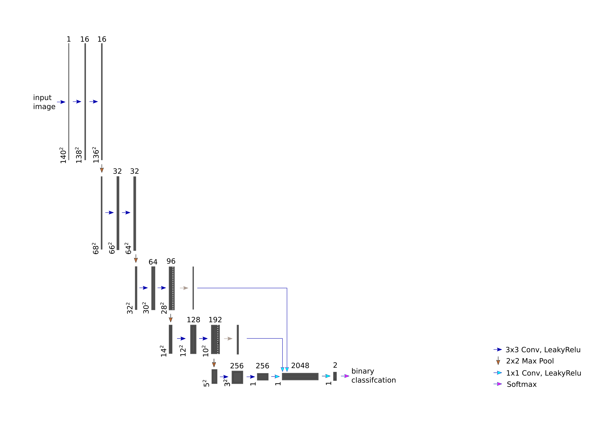
Multi-res “skip” encoder + binary classifier for mSEM data
Encoder:
Freeze weights (keep weights learnt unsupervised)
Classifier:
Learn weights (given labels)

Slide 16
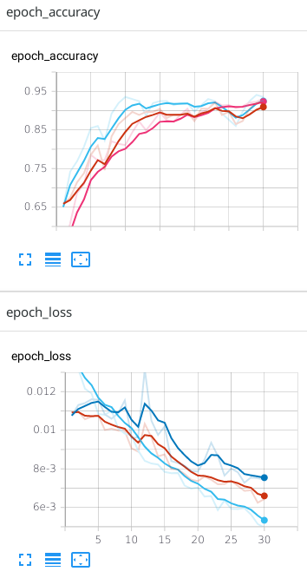
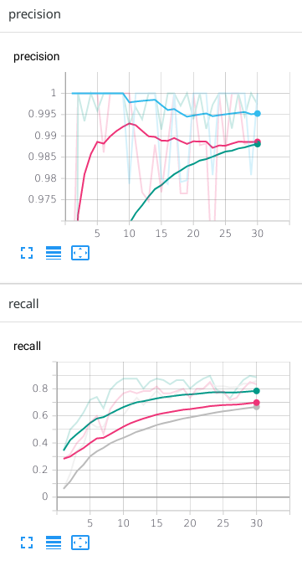
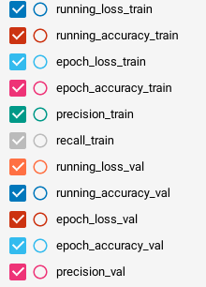
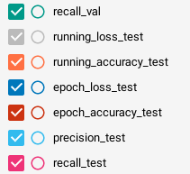
Multi-res “skip” encoder + binary classifier for mSEM data

Slide 17
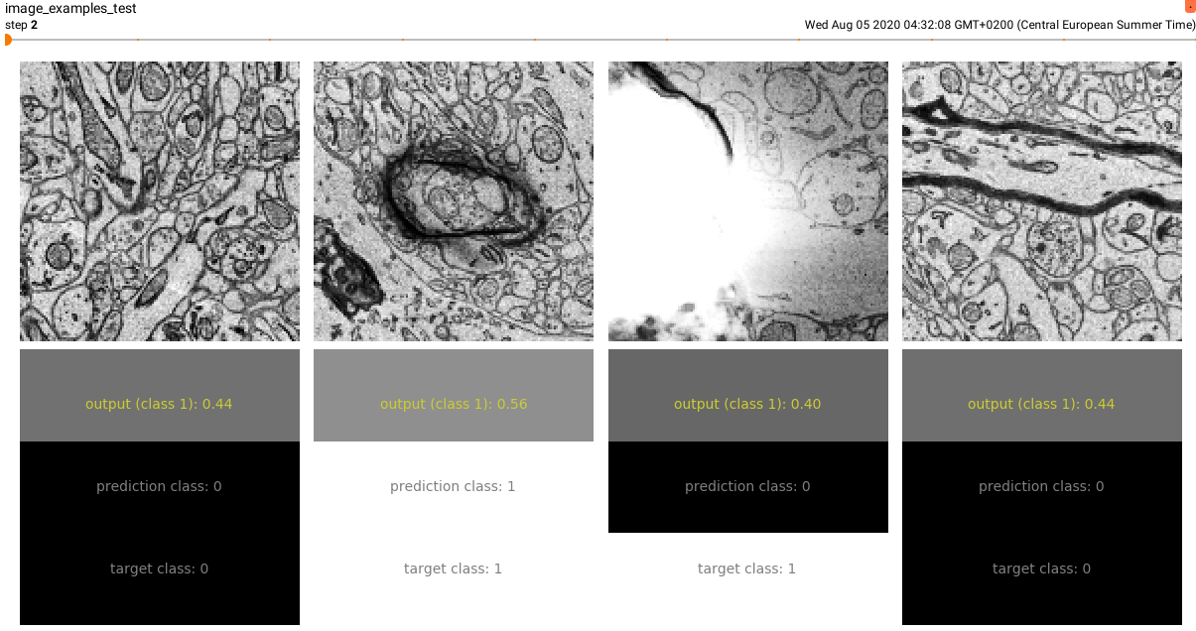
Multi-res “skip” encoder + binary classifier for mSEM data

Slide 18
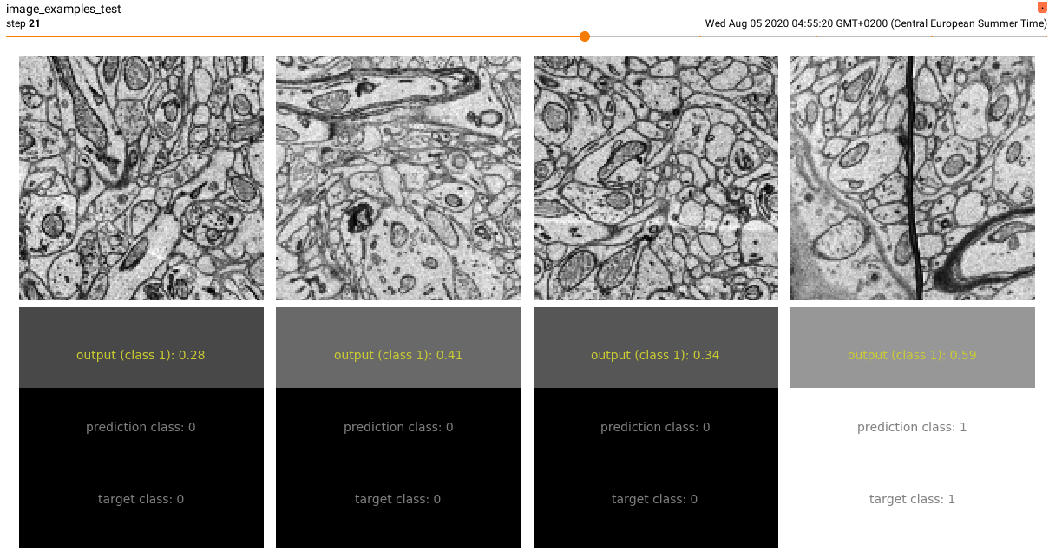
Multi-res “skip” encoder + binary classifier for mSEM data

Slide 19
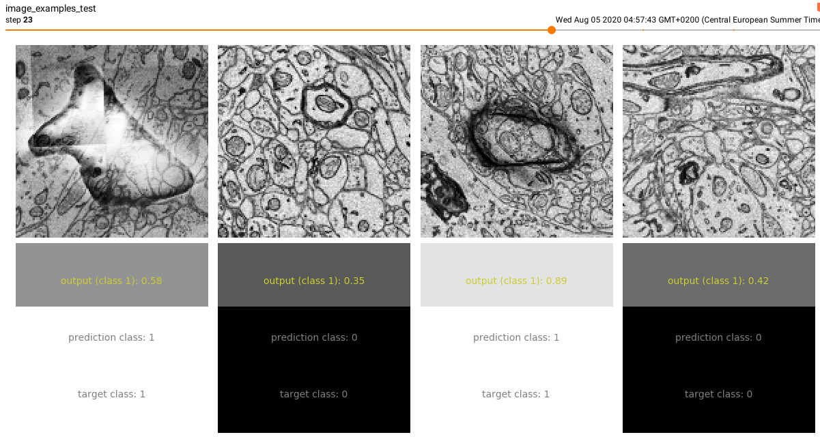
Multi-res “skip” encoder + binary classifier for mSEM data

Slide 20
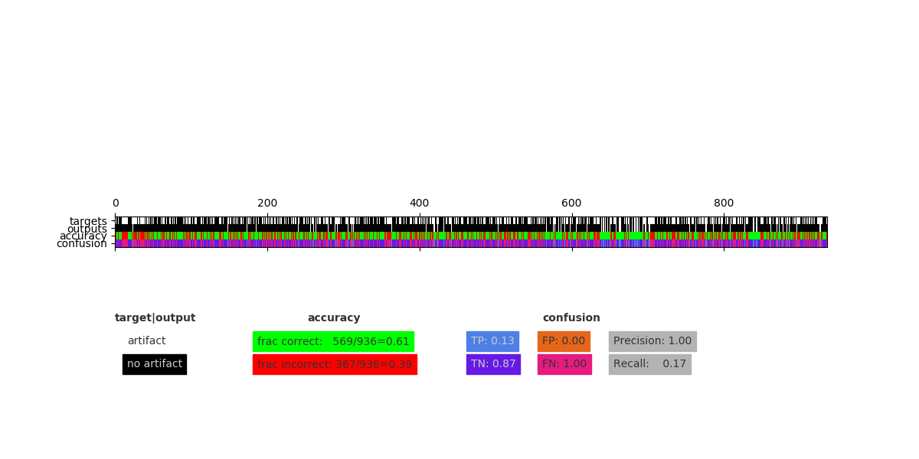
Multi-res “skip” encoder + binary classifier for mSEM data

Slide 21
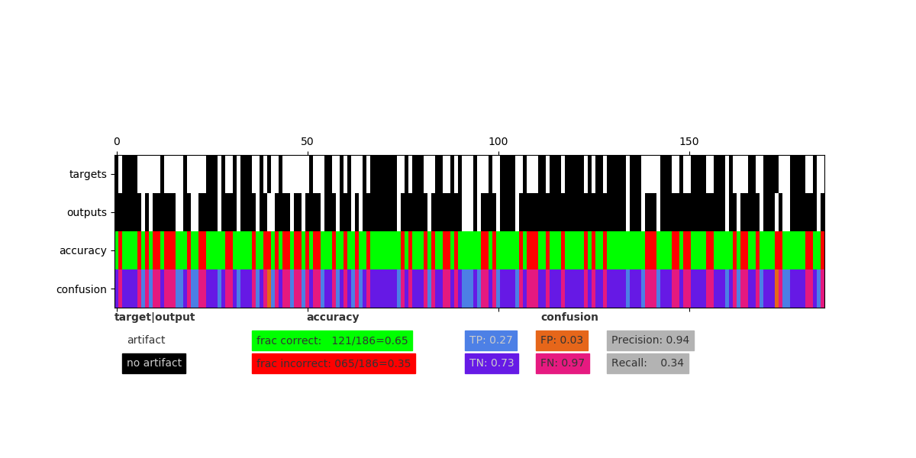
Multi-res “skip” encoder + binary classifier for mSEM data

Slide 22
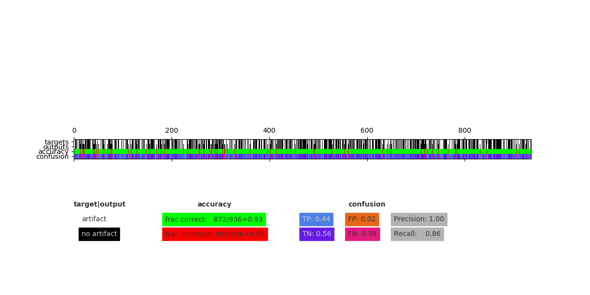
Multi-res “skip” encoder + binary classifier for mSEM data

Slide 23
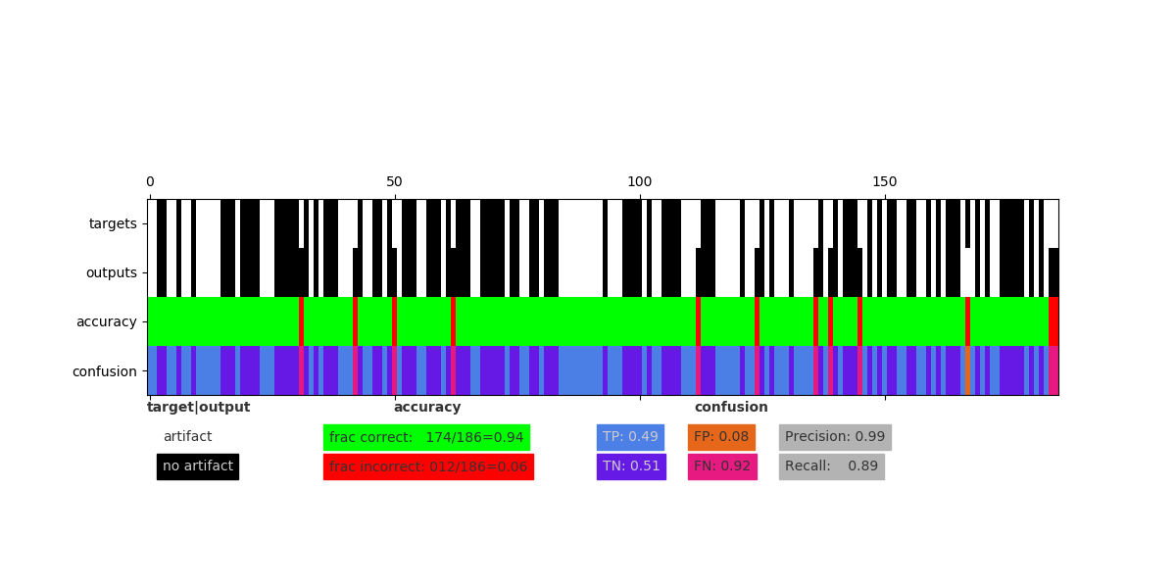
Multi-res “skip” encoder + binary classifier for mSEM data

Slide 24
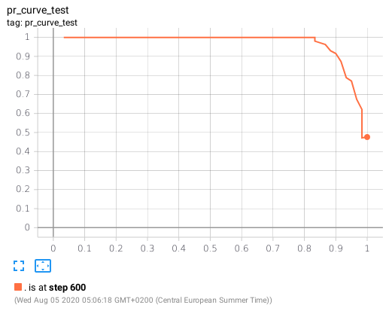
Multi-res “skip” encoder + binary classifier for mSEM data

